Slide 1
Machine Learning and Neural Network
Du Quan
2016-07-14

Slide 2
What is machine learning
Input
Output
Algorithm
Traditional Program
Input
“Algorithm”
Output
ML Program

Slide 3
Types of machine learning
Supervised Learning
Unsupervised Learning
Reinforcement Learning

Slide 4
Supervised Learning
x₂
x₁

Slide 5
Unsupervised Learning
x₂
x₁

Slide 6
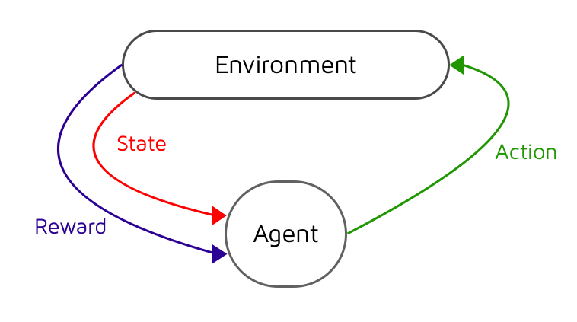
Reinforcement Learning

Slide 7
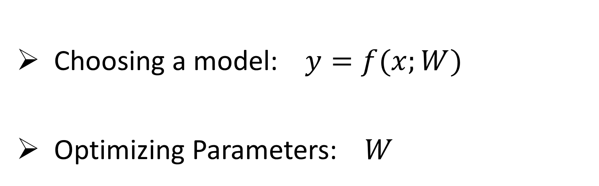
How does Supervised Learning Works
Choosing a model: $y=f(x;W)$
Optimizing Parameters: $W$

Slide 8
Types of Supervised Learning
Regression
Classification

Slide 9
Linear Regression

Slide 10
Example
Given:
height (cm) x | weight(kg) y
155 | 53
165 | 63
168 | 68
153 | 52
160 | 61
158 | 55
Solve:
When height = 163 cm , weight = ?

Slide 11
Example
Given:
height (cm) x | weight(kg) y
155 | 53
165 | 63
168 | 68
153 | 52
160 | 61
158 | 55
Solve:
When height = 163 cm , weight = ?

Slide 12
Example
Given:
height (cm) x | weight(kg) y
155 | 53
165 | 63
168 | 68
153 | 52
160 | 61
158 | 55
Solve:
When height = 163 cm , weight = ?

Slide 13
Example
Given:
height (cm) x | weight(kg) y
155 | 53
165 | 63
168 | 68
153 | 52
160 | 61
158 | 55
Solve:
When height = 163 cm , weight = ?

Slide 14
Example
Given:
height (cm) x | weight(kg) y
155 | 53
165 | 63
168 | 68
153 | 52
160 | 61
158 | 55
Solve:
When height = 163 cm , weight = ?

Slide 15
Cost function

Slide 16
Cost function
height (cm) x | weight(kg) y
155 | 53
165 | 63
168 | 68
153 | 52
160 | 61
158 | 55

Slide 17
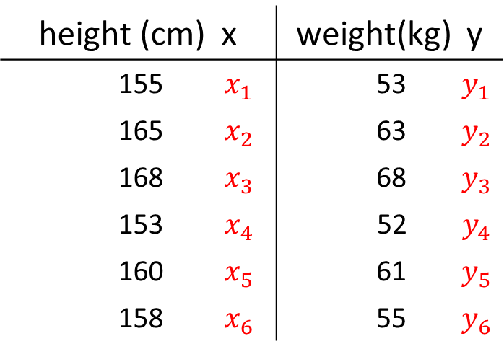
Cost function
height (cm) x | weight(kg) y
155 $x_{1}$ | 53 $y_{1}$
165 $x_{2}$ | 63 $y_{2}$
168 $x_{3}$ | 68 $y_{3}$
153 $x_{4}$ | 52 $y_{4}$
160 $x_{5}$ | 61 $y_{5}$
158 $x_{6}$ | 55 $y_{6}$

Slide 18
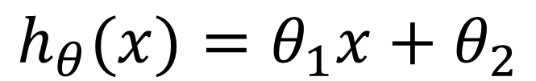
Cost function
$$h_{θ}(x)=θ_{1}x+θ_{2}$$
height (cm) x | weight(kg) y
155 $x_{1}$ | 53 $y_{1}$
165 $x_{2}$ | 63 $y_{2}$
168 $x_{3}$ | 68 $y_{3}$
153 $x_{4}$ | 52 $y_{4}$
160 $x_{5}$ | 61 $y_{5}$
158 $x_{6}$ | 55 $y_{6}$

Slide 19
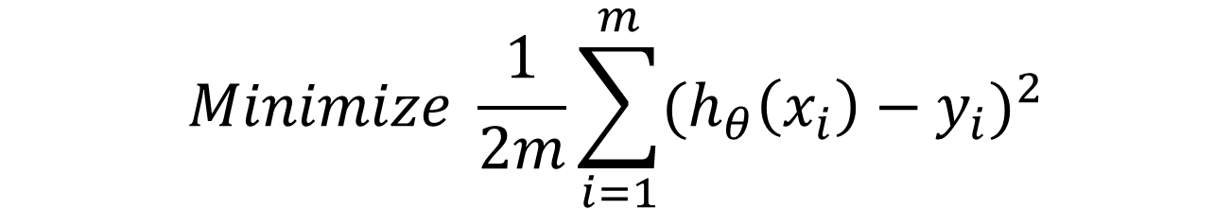
Cost function
$$h_{θ}(x)=θ_{1}x+θ_{2}$$
height (cm) x | weight(kg) y
155 $x_{1}$ | 53 $y_{1}$
165 $x_{2}$ | 63 $y_{2}$
168 $x_{3}$ | 68 $y_{3}$
153 $x_{4}$ | 52 $y_{4}$
160 $x_{5}$ | 61 $y_{5}$
158 $x_{6}$ | 55 $y_{6}$
$$Minimize \frac{1}{2m}\sum_{i=1}^{m}{{(h_{θ}\left(x_{i}\right)−y_{i})}^{2}}$$

Slide 20
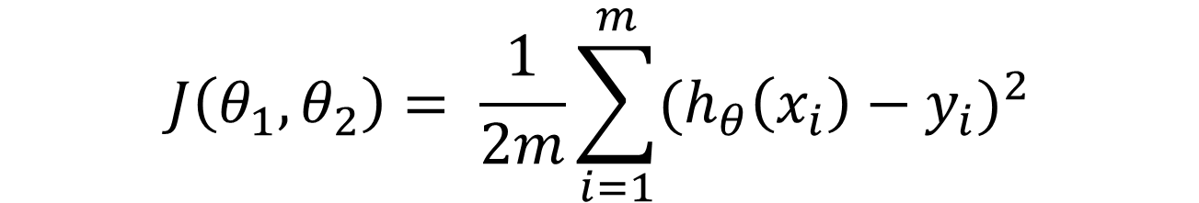
Cost function
$$J\left(θ_{1},θ_{2}\right)= \frac{1}{2m}\sum_{i=1}^{m}{{(h_{θ}\left(x_{i}\right)−y_{i})}^{2}}$$

Slide 21
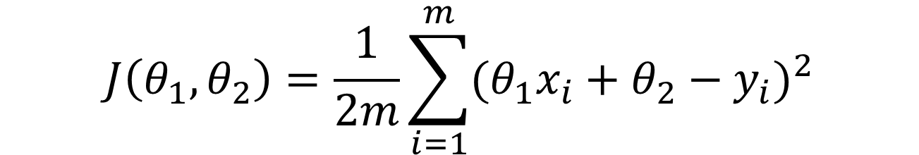
Cost function
$$J\left(θ_{1},θ_{2}\right)= \frac{1}{2m}\sum_{i=1}^{m}{{(h_{θ}\left(x_{i}\right)−y_{i})}^{2}}$$
$$J\left(θ_{1},θ_{2}\right)=\frac{1}{2m}\sum_{i=1}^{m}{{(θ_{1}x_{i}+θ_{2}−y_{i})}^{2}}$$

Slide 22

Cost function
$$J\left(θ_{1},θ_{2}\right)= \frac{1}{2m}\sum_{i=1}^{m}{{(h_{θ}\left(x_{i}\right)−y_{i})}^{2}}$$
$$J\left(θ_{1},θ_{2}\right)=\frac{1}{2m}\sum_{i=1}^{m}{{(θ_{1}x_{i}+θ_{2}−y_{i})}^{2}}$$
Have function
$$J\left(θ_{1},θ_{2}\right)$$

Slide 23
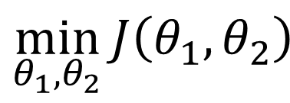
Cost function
$$J\left(θ_{1},θ_{2}\right)= \frac{1}{2m}\sum_{i=1}^{m}{{(h_{θ}\left(x_{i}\right)−y_{i})}^{2}}$$
$$J\left(θ_{1},θ_{2}\right)=\frac{1}{2m}\sum_{i=1}^{m}{{(θ_{1}x_{i}+θ_{2}−y_{i})}^{2}}$$
Have function
$$J\left(θ_{1},θ_{2}\right)$$
Want
$$\min_{θ_{1},θ_{2}}{J\left(θ_{1},θ_{2}\right)}$$

Slide 24
Gradient descent

Slide 25





(for fixed , this is a function of x)
(function of the parameter )
y
x

Slide 26

(for fixed , this is a function of x)
(function of the parameter )
y
$$θ_{1}=1$$
x

Slide 27
(for fixed , this is a function of x)
(function of the parameter )
y
$$θ_{1}=1$$
x
$$J\left(θ_{1} \right)=\frac{1}{2m}\sum_{i=1}^{m}{{(θ_{1}x_{i}−y_{i})}^{2}=\frac{1}{2×3}\left({\left(1−1\right)}^{2}+{\left(2−2\right)}^{2}+{\left(3−3\right)}^{2}\right)=0}$$

Slide 28
(for fixed , this is a function of x)
(function of the parameter )
y
$$θ_{1}=1$$
x
$$J\left(θ_{1} \right)=\frac{1}{2m}\sum_{i=1}^{m}{{(θ_{1}x_{i}−y_{i})}^{2}=\frac{1}{2×3}\left({\left(1−1\right)}^{2}+{\left(2−2\right)}^{2}+{\left(3−3\right)}^{2}\right)=0}$$

Slide 29

(for fixed , this is a function of x)
(function of the parameter )
y
$$θ_{1}=0.5$$
x

Slide 30
(for fixed , this is a function of x)
(function of the parameter )
y
$$θ_{1}=0.5$$
x

Slide 31
(for fixed , this is a function of x)
(function of the parameter )
y
$$θ_{1}=0.5$$
x
$$J\left(θ_{1} \right)=\frac{1}{2m}\sum_{i=1}^{m}{{(θ_{1}x_{i}−y_{i})}^{2}=\frac{1}{2×3}\left({\left(0.5−1\right)}^{2}+{\left(1−2\right)}^{2}+{\left(1.5−3\right)}^{2}\right)≈0.58}$$

Slide 32
(for fixed , this is a function of x)
(function of the parameter )
y
$$θ_{1}=0.5$$
x
$$J\left(θ_{1} \right)=\frac{1}{2m}\sum_{i=1}^{m}{{(θ_{1}x_{i}−y_{i})}^{2}=\frac{1}{2×3}\left({\left(0.5−1\right)}^{2}+{\left(1−2\right)}^{2}+{\left(1.5−3\right)}^{2}\right)≈0.58}$$

Slide 33

(for fixed , this is a function of x)
(function of the parameter )
y
$$θ_{1}=0$$
x
$$J\left(θ_{1} \right)=\frac{1}{2m}\sum_{i=1}^{m}{{(θ_{1}x_{i}−y_{i})}^{2}=\frac{1}{2×3}\left({\left(0−1\right)}^{2}+{\left(0−2\right)}^{2}+{\left(0−3\right)}^{2}\right)≈2.3}$$

Slide 34

(for fixed , this is a function of x)
(function of the parameter )
y
$$θ_{1}=1.5$$
x

Slide 35

(for fixed , this is a function of x)
(function of the parameter )
y
$$θ_{1}=2$$
x

Slide 36
(for fixed , this is a function of x)
(function of the parameter )
y
x

Slide 37
(for fixed , this is a function of x)
(function of the parameter )
y
$$θ_{1}=1$$
x

Slide 38


Gradient descent
$${J(θ}_{1})$$
$$θ_{1}$$

Slide 39
Gradient descent
$${J(θ}_{1})$$
$$θ_{1}$$

Slide 40
Gradient descent
$${J(θ}_{1})$$
$$θ_{1}$$

Slide 41
Gradient descent
$${J(θ}_{1})$$
$$θ_{1}$$

Slide 42
Gradient descent
$${J(θ}_{1})$$
$$θ_{1}$$

Slide 43
Gradient descent
$${J(θ}_{1})$$
$$θ_{1}$$

Slide 44
Gradient descent
$${J(θ}_{1})$$
$$θ_{1}$$

Slide 45

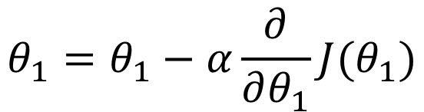



Gradient descent
$$repeat until convergence$$
$$\{$$
$${J(θ}_{1})$$
$$θ_{1}=θ_{1}−α\frac{∂}{∂θ_{1}}J(θ_{1})$$
$$\}$$
$$θ_{1}$$

Slide 46

Gradient descent
$$repeat until convergence$$
$$\{$$
$${J(θ}_{1})$$
$$θ_{1}=θ_{1}−α\frac{∂}{∂θ_{1}}J(θ_{1})$$
$$\}$$
$$θ_{1}$$
$$α: learning rate$$

Slide 47
Gradient descent
$${J(θ}_{1})$$
$$θ_{1}$$

Slide 48
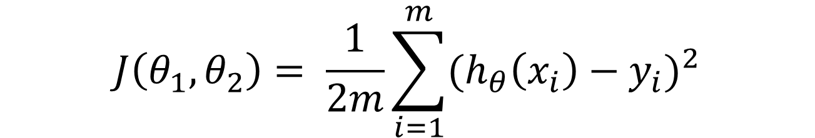
Gradient descent
$$h_{θ}(x)=θ_{1}x+θ_{2}$$
height (cm) x | weight(kg) y
155 $x_{1}$ | 53 $y_{1}$
165 $x_{2}$ | 63 $y_{2}$
168 $x_{3}$ | 68 $y_{3}$
153 $x_{4}$ | 52 $y_{4}$
160 $x_{5}$ | 61 $y_{5}$
158 $x_{6}$ | 55 $y_{6}$
$$J\left(θ_{1},θ_{2}\right)= \frac{1}{2m}\sum_{i=1}^{m}{{(h_{θ}\left(x_{i}\right)−y_{i})}^{2}}$$

Slide 49
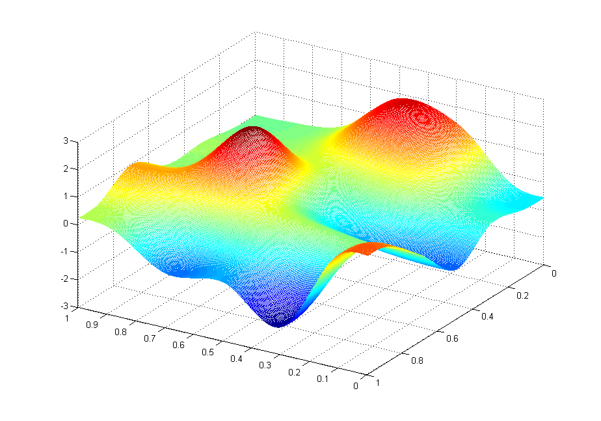



Gradient descent
$${J(θ}_{1}, θ_{2})$$
$$θ_{2}$$
$$θ_{1}$$

Slide 50
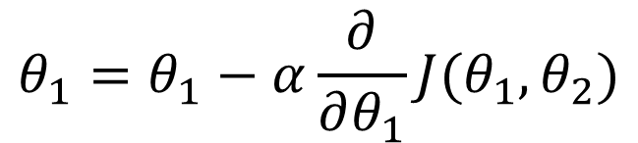
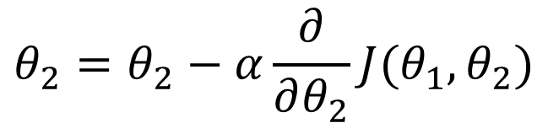



Gradient descent
$$repeat until convergence$$
$$\{$$
$$θ_{1}=θ_{1}−α\frac{∂}{∂θ_{1}}J(θ_{1},θ_{2})$$
$$θ_{2}=θ_{2}−α\frac{∂}{∂θ_{2}}J(θ_{1},θ_{2})$$
$$\}$$
$$α: learning rate$$

Slide 51

Gradient descent
$${J(θ}_{1}, θ_{2})$$
$$θ_{2}$$
$$θ_{1}$$

Slide 52
Gradient descent
$${J(θ}_{1}, θ_{2})$$
$$θ_{2}$$
$$θ_{1}$$

Slide 53
Gradient descent
$${J(θ}_{1}, θ_{2})$$
$$θ_{2}$$
$$θ_{1}$$

Slide 54
Gradient descent
$${J(θ}_{1}, θ_{2})$$
$$θ_{2}$$
$$θ_{1}$$

Slide 55
Gradient descent
$${J(θ}_{1}, θ_{2})$$
$$θ_{2}$$
$$θ_{1}$$

Slide 56
Gradient descent
$${J(θ}_{1}, θ_{2})$$
$$θ_{2}$$
$$θ_{1}$$

Slide 57
Gradient descent
$${J(θ}_{1}, θ_{2})$$
$$θ_{2}$$
$$θ_{1}$$

Slide 58
Gradient descent
$${J(θ}_{1}, θ_{2})$$
$$θ_{2}$$
$$θ_{1}$$

Slide 59
Gradient descent
$${J(θ}_{1}, θ_{2})$$
$$θ_{2}$$
$$θ_{1}$$

Slide 60
Gradient descent
$${J(θ}_{1}, θ_{2})$$
$$θ_{2}$$
$$θ_{1}$$

Slide 61
Gradient descent
$${J(θ}_{1}, θ_{2})$$
$$θ_{2}$$
$$θ_{1}$$

Slide 62
Gradient descent
$${J(θ}_{1}, θ_{2})$$
$$θ_{2}$$
$$θ_{1}$$

Slide 63
Gradient descent
$${J(θ}_{1}, θ_{2})$$
$$θ_{2}$$
$$θ_{1}$$

Slide 64
Gradient descent
$${J(θ}_{1}, θ_{2})$$
$$θ_{2}$$
$$θ_{1}$$

Slide 65
Gradient descent
$${J(θ}_{1}, θ_{2})$$
$$θ_{2}$$
$$θ_{1}$$

Slide 66
Gradient descent
$${J(θ}_{1}, θ_{2})$$
$$θ_{2}$$
$$θ_{1}$$

Slide 67
Gradient descent
$${J(θ}_{1}, θ_{2})$$
$$θ_{2}$$
$$θ_{1}$$

Slide 68
Gradient descent
$${J(θ}_{1}, θ_{2})$$
$$θ_{2}$$
$$θ_{1}$$

Slide 69
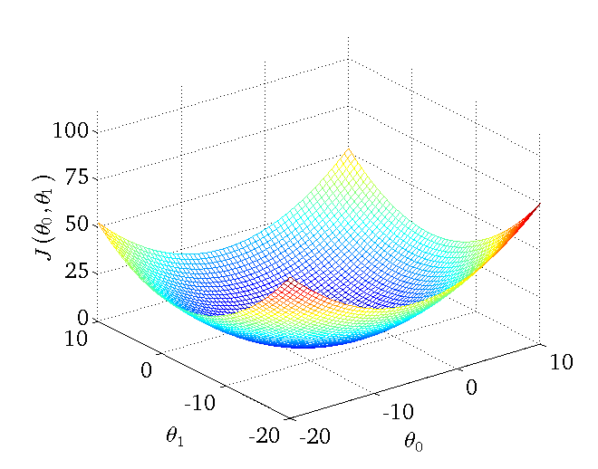
Gradient descent

Slide 70
Gradient descent
Batch Gradient Descent
Stochastic Gradient Descent
Minibatch SGD
Online GD

Slide 71
Multiple Variables

Slide 72
Multiple Variables
$h_{θ}\left(x_{1,}x_{2,}…,x_{m}\right)=θ_{1}x_{1}+θ_{2}x_{2}+…+θ_{m}x_{m}$+$θ_{m+1}$

Slide 73


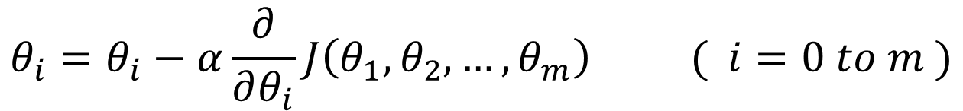
Multiple Variables
$h_{θ}\left(x_{1,}x_{2,}…,x_{m}\right)=θ_{1}x_{1}+θ_{2}x_{2}+…+θ_{m}x_{m}$+$θ_{m+1}$
$$repeat until convergence$$
$$\{$$
$$θ_{i}=θ_{i}−α\frac{∂}{∂θ_{i}}J\left(θ_{1},θ_{2},…,θ_{m}\right) ( i=0 to m )$$
$$\}$$

Slide 74
Polynomial regression

Slide 75
Polynomial regression

Slide 76
Polynomial regression
$$h_{θ}=θ_{1}x+θ_{2}x^{2}+θ_{3}$$

Slide 77
What is linear regression?
An approach for modeling the relationship between a scalar dependent variable y and one or more explanatory variables denoted X.

Slide 78
How to deal with linear regression problem?
1、Define a model

Slide 79
How to deal with linear regression problem?
1、Define a model
2、Define the best matching (cost function)

Slide 80
How to deal with linear regression problem?
1、Define a model
2、Define the best matching (cost function)
3、Use the model to match labeled data (training)

Slide 81
Logistic Regression

Slide 82
Example
(Yes) 1
Malignant ?
(No) 0
Tumor Size

Slide 83
Why not use linear regression?

Slide 84
Why not use linear regression?
1、Range of values

Slide 85
Why not use linear regression?
1、Range of values
2、Great influence when exist big or small sample

Slide 86
Problem I
(Yes) 1
Malignant ?
(No) 0
Tumor Size

Slide 87
Problem I
(Yes) 1
Malignant ?
(No) 0
Tumor Size

Slide 88
Problem II
(Yes) 1
Malignant ?
(No) 0
Tumor Size

Slide 89
Problem II
(Yes) 1
Malignant ?
(No) 0
Tumor Size

Slide 90
Problem II
(Yes) 1
Malignant ?
(No) 0
Tumor Size

Slide 91
Problem II
(Yes) 1
Malignant ?
(No) 0
Tumor Size

Slide 92
Problem II
(Yes) 1
Malignant ?
(No) 0
Tumor Size

Slide 93
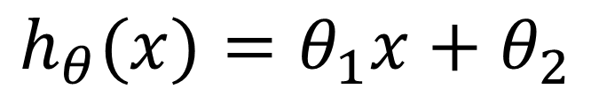
Linear regression
$$h_{θ}(x)=θ_{1}x+θ_{2}$$

Slide 94
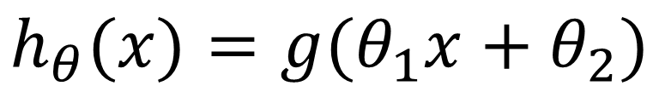
Linear regression
$$h_{θ}(x)=θ_{1}x+θ_{2}$$
Logistic regression
$$h_{θ}(x)=g(θ_{1}x+θ_{2})$$

Slide 95
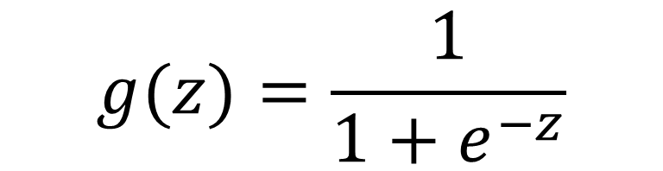
Linear regression
$$h_{θ}(x)=θ_{1}x+θ_{2}$$
Logistic regression
$$h_{θ}(x)=g(θ_{1}x+θ_{2})$$
$$g(z)=\frac{1}{1+e^{−z}}$$

Slide 96
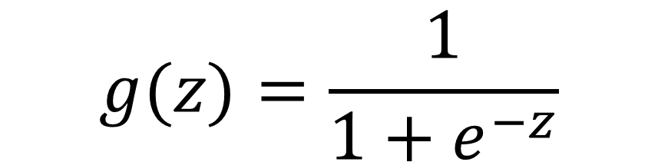



Sigmoid function
$$1$$
$$g(z)$$
$$g(z)=\frac{1}{1+e^{−z}}$$
$$z$$

Slide 97

Cost function
$$J\left(θ_{1} \right)= \frac{1}{2m}\sum_{i=1}^{m}{{(h_{θ}\left(x_{i}\right)−y_{i})}^{2}}$$

Slide 98
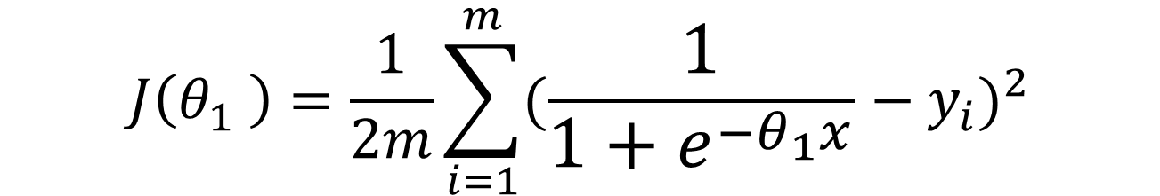
Cost function
$$J\left(θ_{1} \right)= \frac{1}{2m}\sum_{i=1}^{m}{{(h_{θ}\left(x_{i}\right)−y_{i})}^{2}}$$
$$J\left(θ_{1} \right)=\frac{1}{2m}\sum_{i=1}^{m}{{(\frac{1}{1+e^{−θ_{1}x}}−y_{i})}^{2}}$$

Slide 99
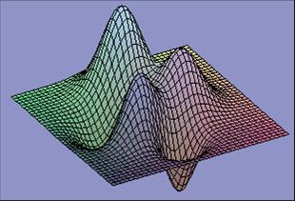
Gradient descent

Slide 100
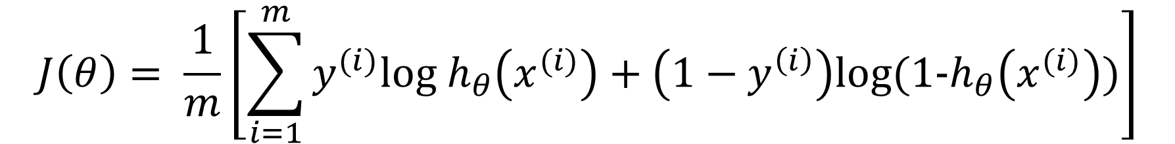
Cost function
$$J\left(θ\right)= \frac{1}{m}\left[\sum_{i=1}^{m}{y^{(i)}log h_{θ}\left(x^{(i)}\right)}+\left(1−y^{\left(i\right)}\right)log⁡(1−h_{θ}\left(x^{(i)}\right))\right]$$

Slide 101


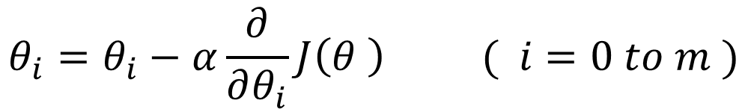
Cost function
$$J\left(θ\right)= \frac{1}{m}\left[\sum_{i=1}^{m}{y^{(i)}log h_{θ}\left(x^{(i)}\right)}+\left(1−y^{\left(i\right)}\right)log⁡(1−h_{θ}\left(x^{(i)}\right))\right]$$
$$repeat until convergence$$
$$\{$$
$$θ_{i}=θ_{i}−α\frac{∂}{∂θ_{i}}J\left(θ \right) ( i=0 to m )$$
$$\}$$

Slide 102

Maximum Likelihood Estimation
$$Becase of binary classification , so y=0 or y=1$$

Slide 103
Maximum Likelihood Estimation
$$Becase of binary classification , so y=0 or y=1$$
$$P\left(y=1 | x;θ\right)=h_{θ}(x)$$
$$P\left(y=0 | x;θ\right)={1−h}_{θ}(x)$$

Slide 104
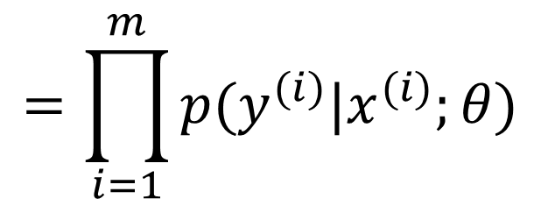
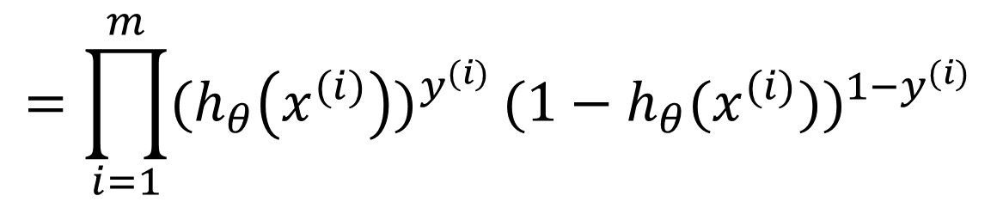
Maximum Likelihood Estimation
$$L\left(θ\right)=p\left(\vec{y} | X;θ\right)$$
$$=\prod_{i=1}^{m}{p(y^{(i)}|x^{(i)};θ)}$$
$$=\prod_{i=1}^{m}{{{(h}_{θ}\left(x^{(i)}\right))}^{y^{(i)}}}{(1−h_{θ}(x^{(i)}))}^{{1−y}^{(i)}}$$

Slide 105
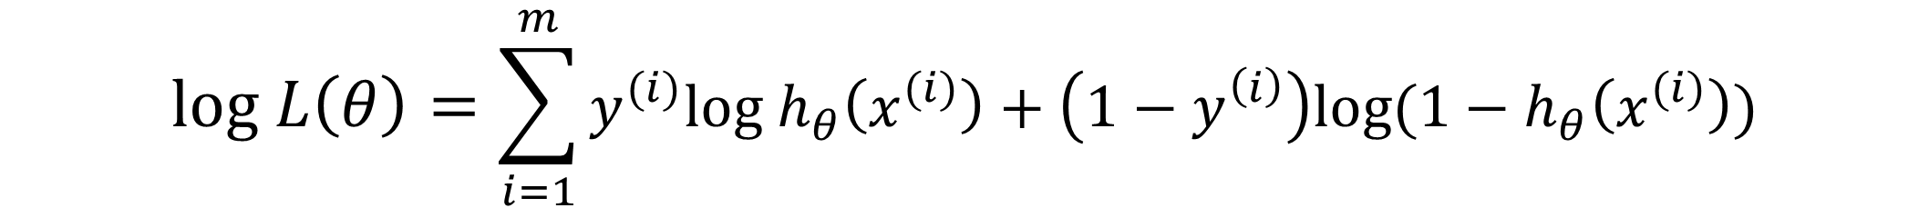
Maximum Likelihood Estimation
$$L\left(θ\right)=p\left(\vec{y} | X;θ\right)$$
$$=\prod_{i=1}^{m}{p(y^{(i)}|x^{(i)};θ)}$$
$$=\prod_{i=1}^{m}{{{(h}_{θ}\left(x^{(i)}\right))}^{y^{(i)}}}{(1−h_{θ}(x^{(i)}))}^{{1−y}^{(i)}}$$
$$log L\left(θ\right)=\sum_{i=1}^{m}{y^{(i)}log h_{θ}\left(x^{(i)}\right)}+\left(1−y^{\left(i\right)}\right)log⁡(1−h_{θ}\left(x^{(i)}\right))$$

Slide 106
Neural Networks

Slide 107
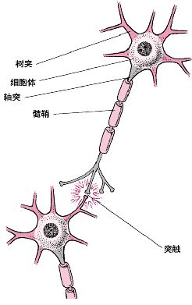
Neuron

Slide 108
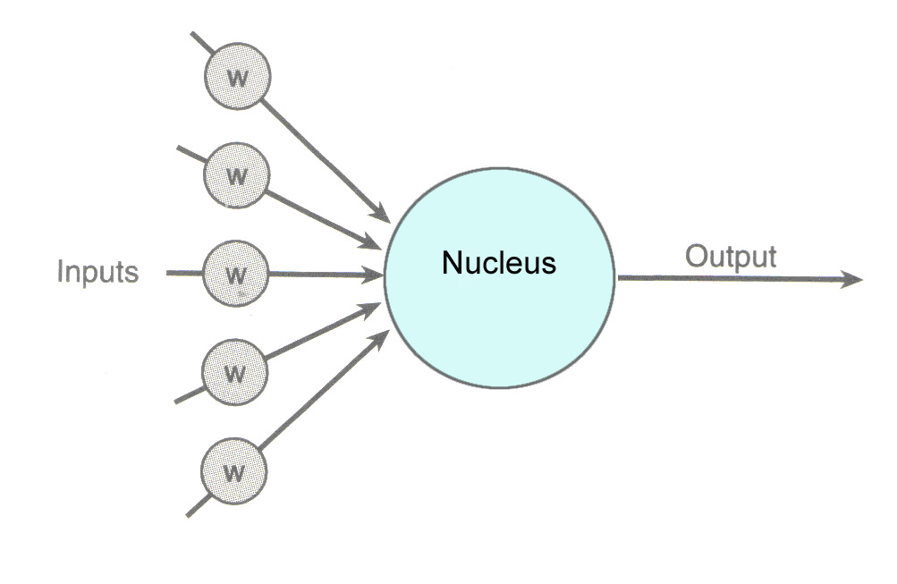
Neuron

Slide 109




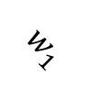

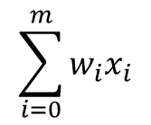


Neural Networks
$$x_{1}$$
$$w_{1}$$
$$x_{2}$$
$$w_{2}$$
$$\sum_{i=0}^{m}{w_{i}x_{i}}$$
$$w_{3}$$
Linear regression
$$x_{3}$$
$$w_{4}$$
$$x_{4}$$

Slide 110

Neural Networks
$$x_{1}$$
$$w_{1}$$
$$x_{2}$$
$$w_{2}$$
$$g\left(\sum_{i=0}^{m}{w_{i}x_{i}}\right)$$
$$w_{3}$$
Logistic regression
$$x_{3}$$
$$w_{4}$$
$$x_{4}$$

Slide 111
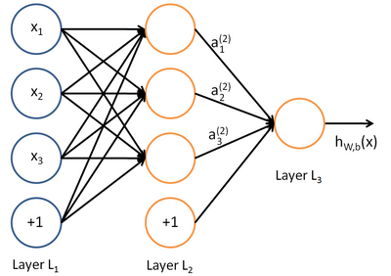
Neural Networks

Slide 112
Why Neural Networks
x₂
x₁

Slide 113
Neural Networks
Forward Propagation
Back Propagation

Slide 114

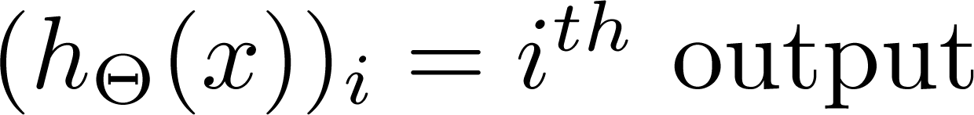
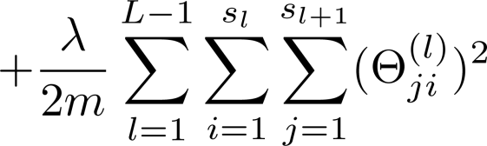
Cost function
Logistic regression:
Neural network:

Slide 115
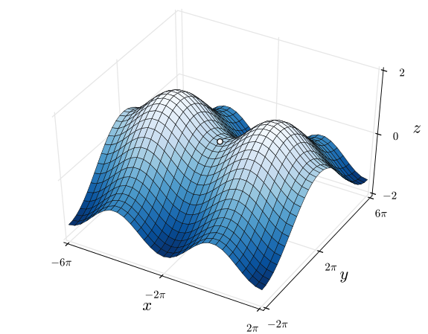
Gradient descent
Saddle Points

Slide 116
OVER

